Slide 1
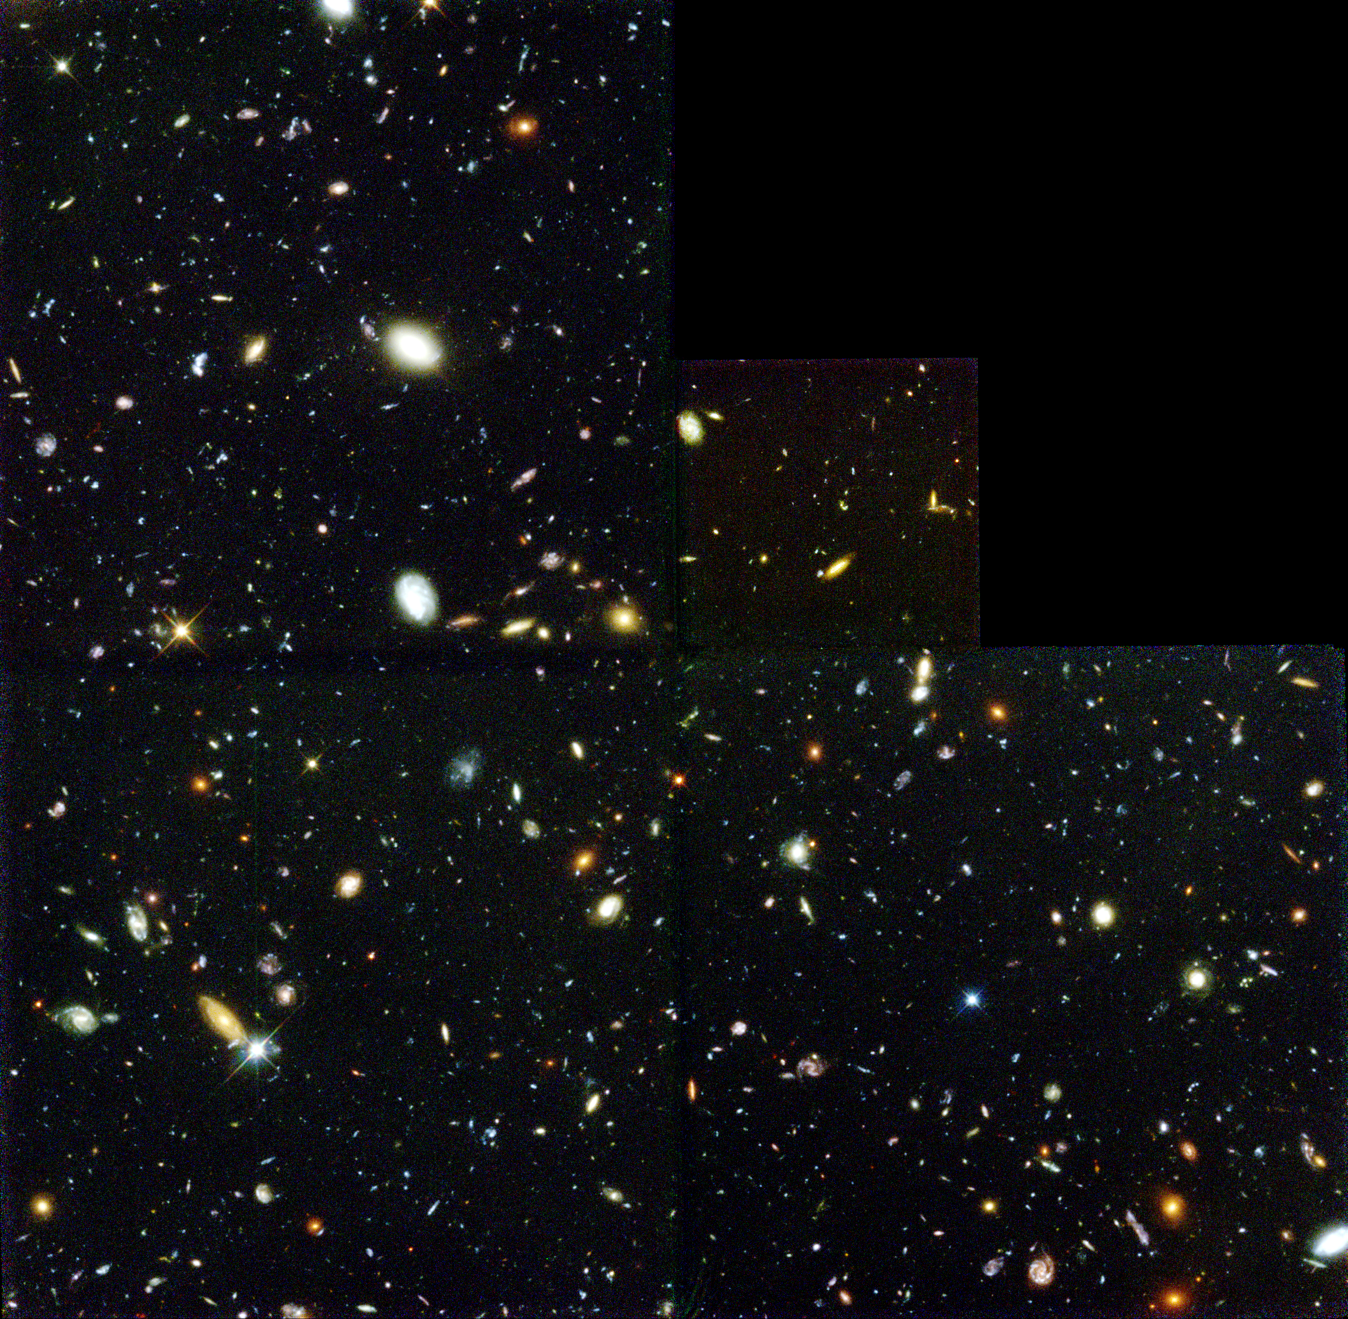
The Universe Around Us Unit 2: Cosmology (day three)

Slide 2
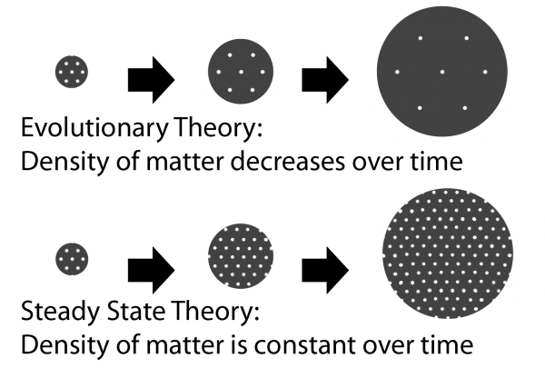
(e.g., Lemaître)
(e.g., Hoyle)

Slide 3
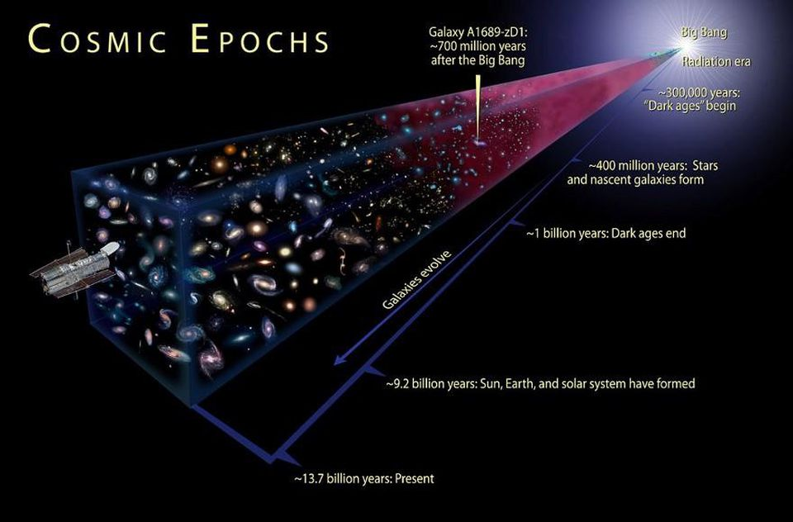
If “Big Bang”,
there is radiation at the beggining

Slide 4
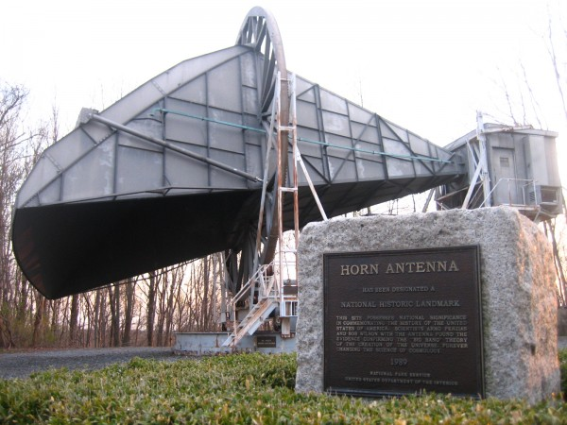

Slide 5
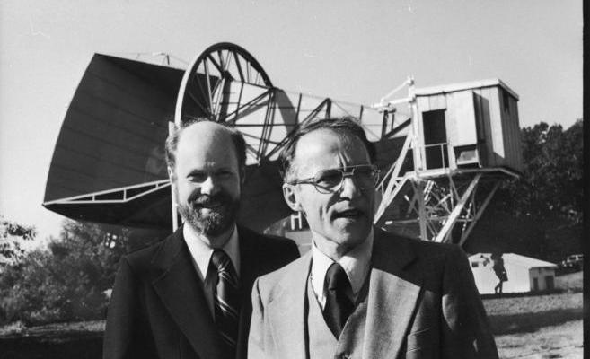
Lemaître
1500 1600 1700 1800 1900 2000
Copernicus
Galilei (1564-1642)
Lagrange (1736-1813)
Young
Maxwell
Noether (1882-1935)
Einstein
Brahe (1546-1601)
Kepler
Newton
Hamilton (1805-1865)
Leavitt
Planck
Hubble
(1933-)
(1936-)
Robert Wilson
Arno Penzias

Slide 6
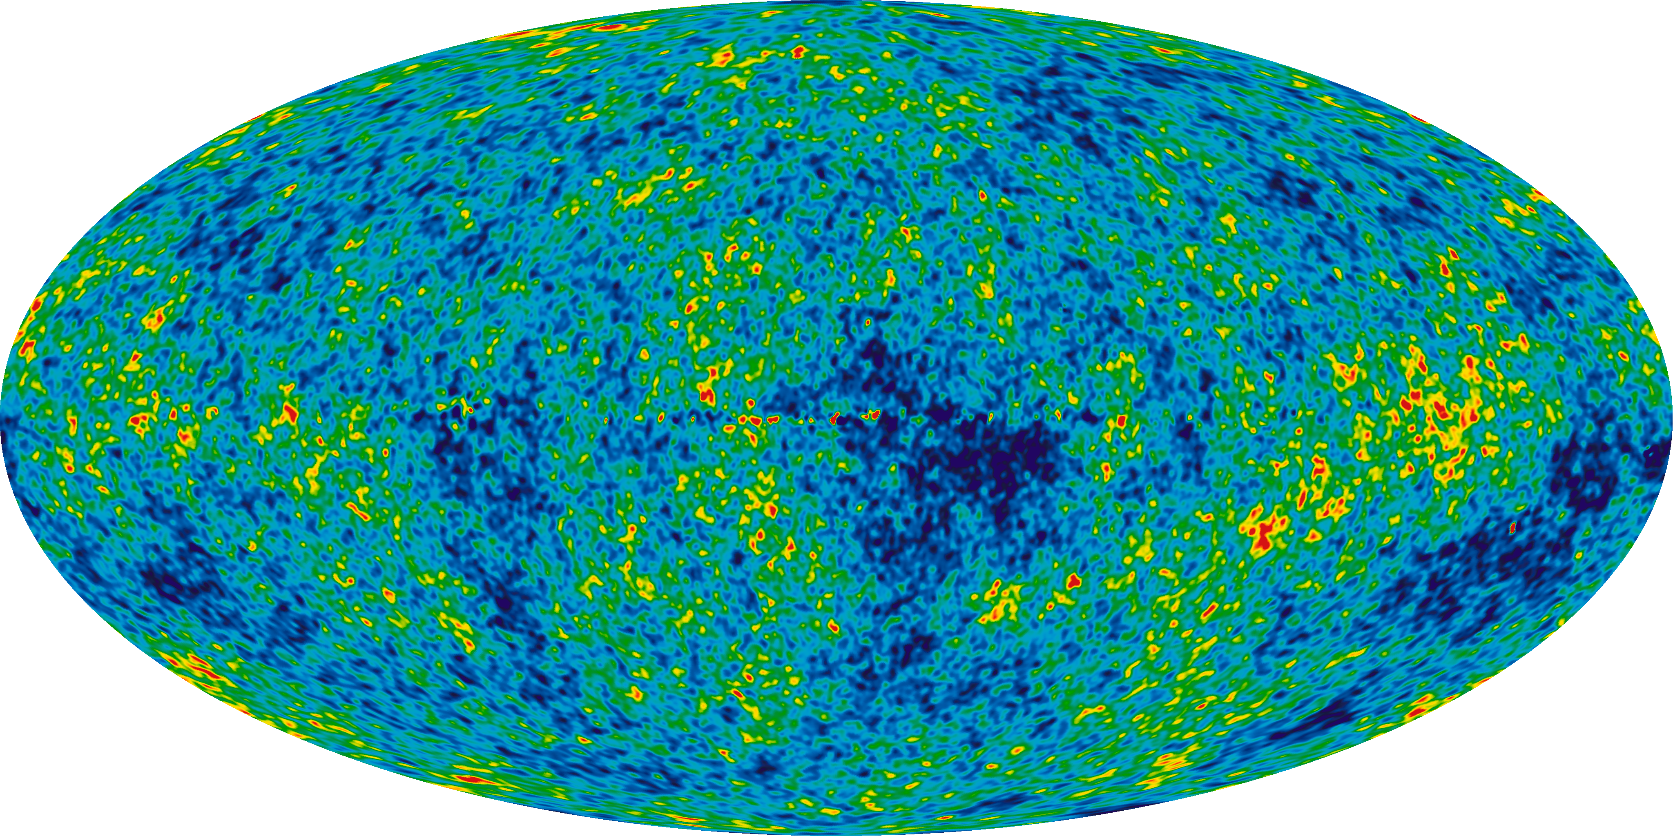
(2001-2010)
WMAP

Slide 7
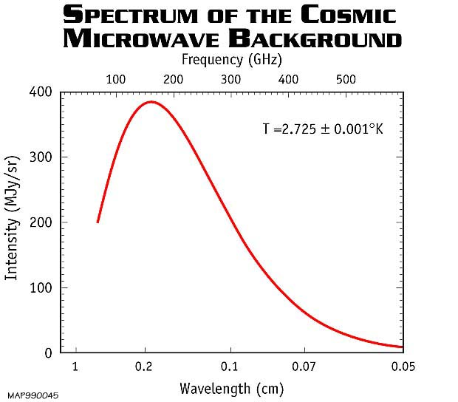
(2001-2010)
WMAP

Slide 8
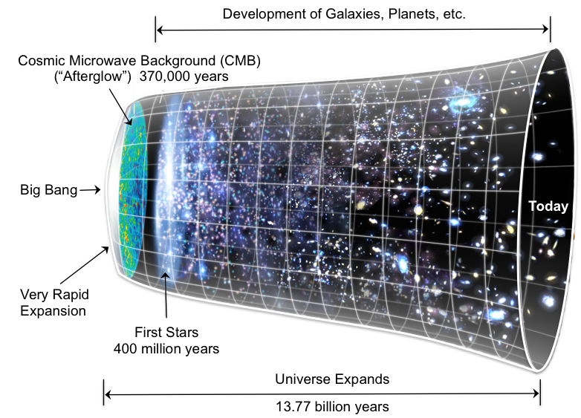

Slide 9
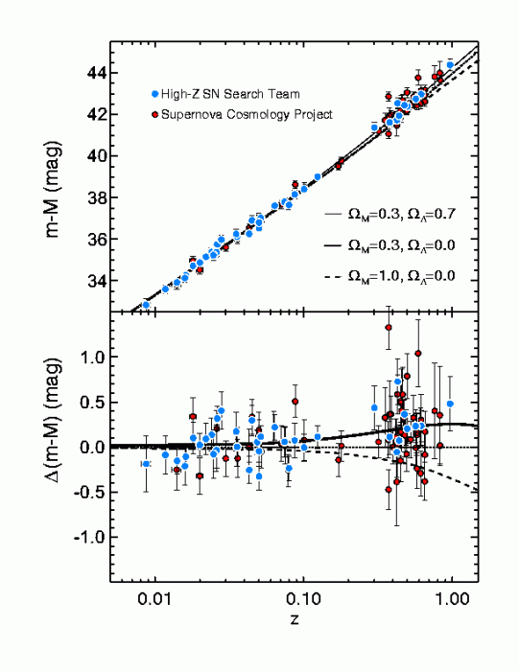
Accelerated expansion
Constant expansion

Slide 10
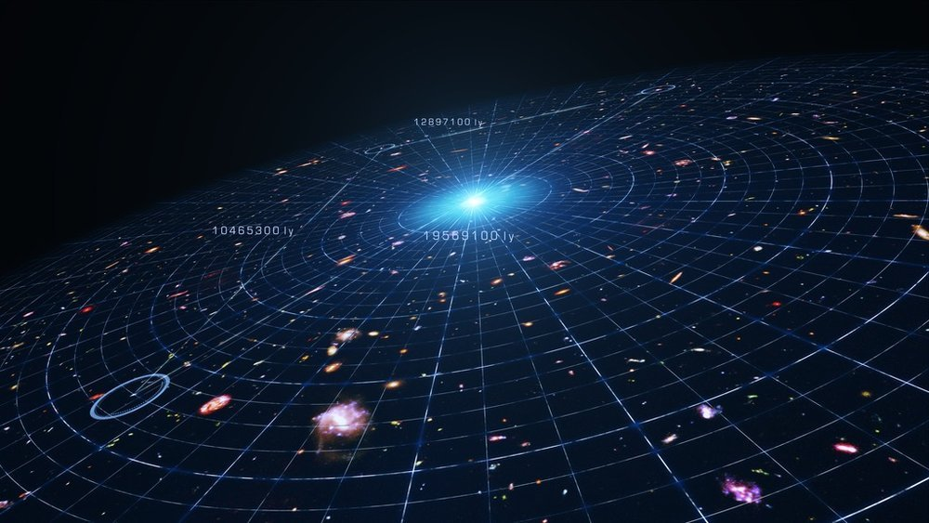
Lemaître
1500 1600 1700 1800 1900 2000
Copernicus
Galilei (1564-1642)
Lagrange (1736-1813)
Young
Maxwell
Noether (1882-1935)
Einstein
Dark Energy
Newton
Brahe (1546-1601)
Kepler
Hamilton (1805-1865)
Leavitt
Planck
Hubble

Slide 11
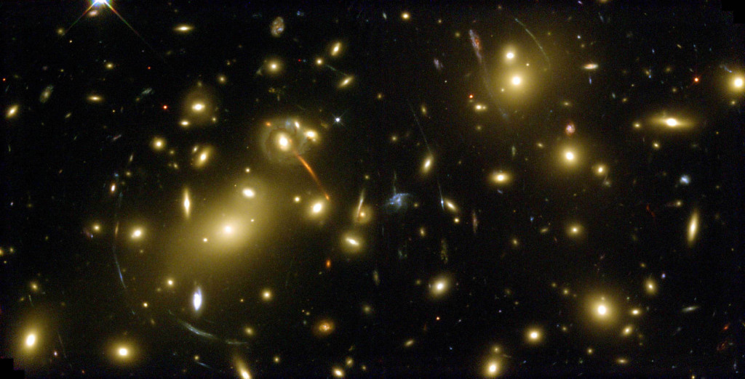
Lemaître
1500 1600 1700 1800 1900 2000
Copernicus
Galilei (1564-1642)
Lagrange (1736-1813)
Young
Maxwell
Noether (1882-1935)
Einstein
Brahe (1546-1601)
Kepler
Newton
Hamilton (1805-1865)
Leavitt
Planck
Hubble
Dark Matter

Slide 12
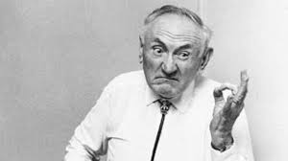
Lemaître
1500 1600 1700 1800 1900 2000
Copernicus
Galilei (1564-1642)
Lagrange (1736-1813)
Young
Maxwell
Noether (1882-1935)
Einstein
Brahe (1546-1601)
Kepler
Newton
Hamilton (1805-1865)
Leavitt
Planck
Hubble
Dark Matter
(first proposed by Franz Zwicky in 1933)

Slide 13
Lemaître
1500 1600 1700 1800 1900 2000
Copernicus
Galilei (1564-1642)
Lagrange (1736-1813)
Young
Maxwell
Noether (1882-1935)
Einstein
Brahe (1546-1601)
Kepler
Newton
Hamilton (1805-1865)
Leavitt
Planck
Hubble
Dark Matter
(first proposed by Franz Zwicky in 1933)

Slide 14

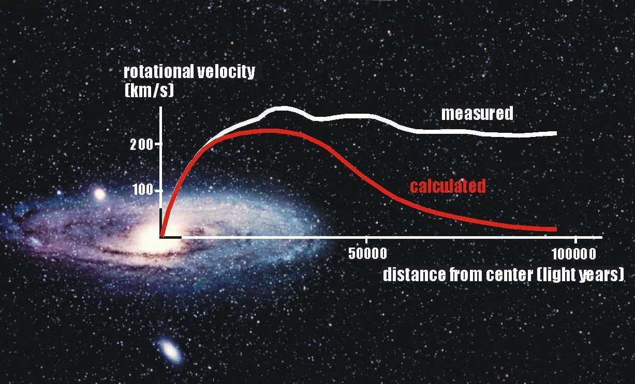
Dark Matter
(proved by Vera Rubin)
(1928-2016)

Slide 15
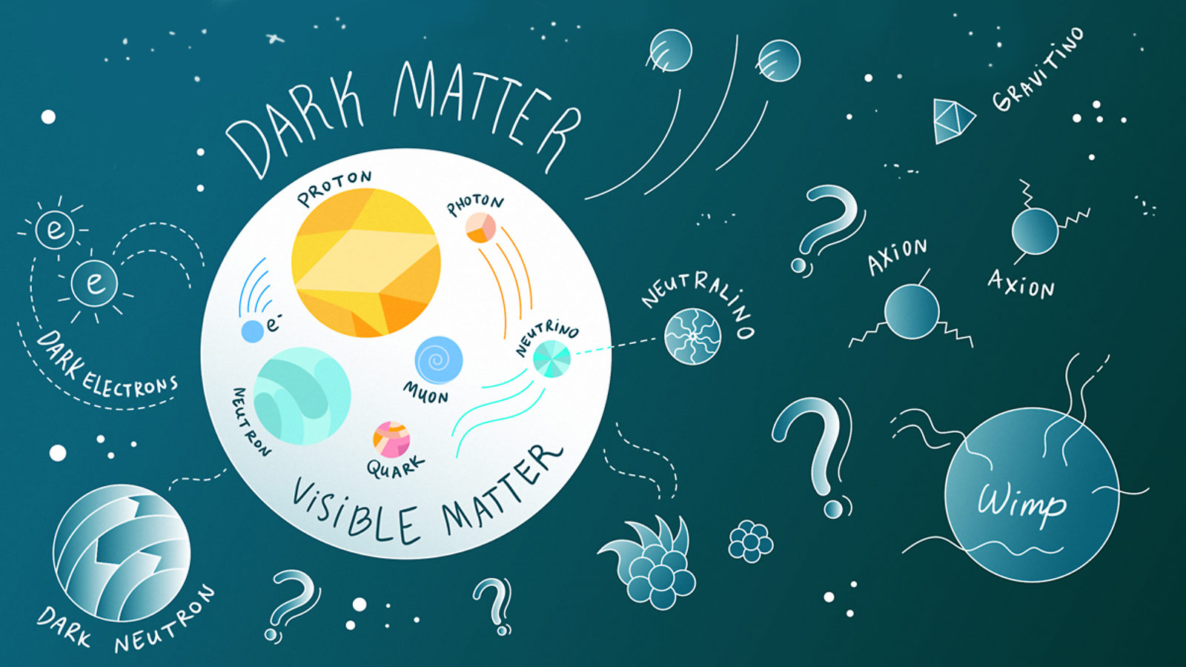
What is Dark Matter?

Slide 16
(2001-2010)
WMAP

Slide 17
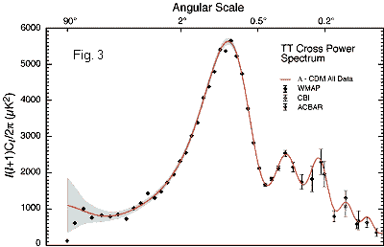
(2001-2010)
WMAP

Slide 18
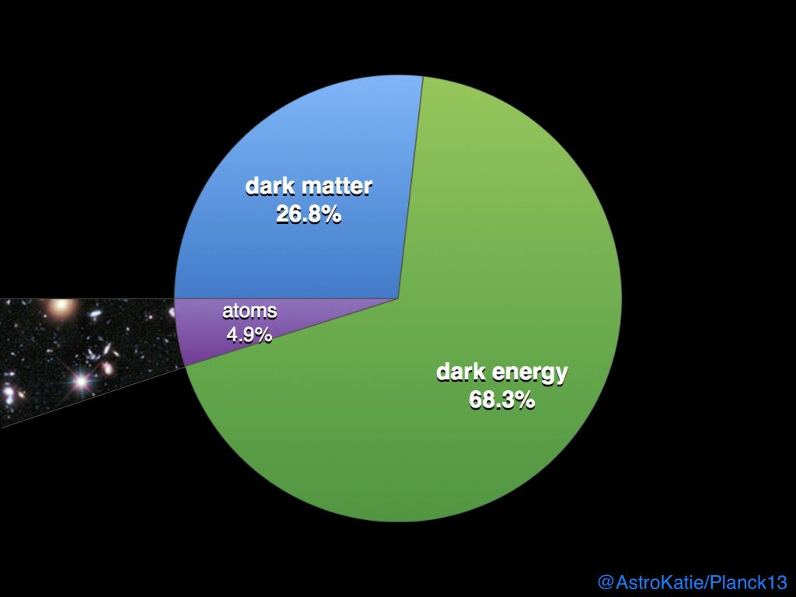

Slide 19
(almost 4%
Is H and He)

Slide 20
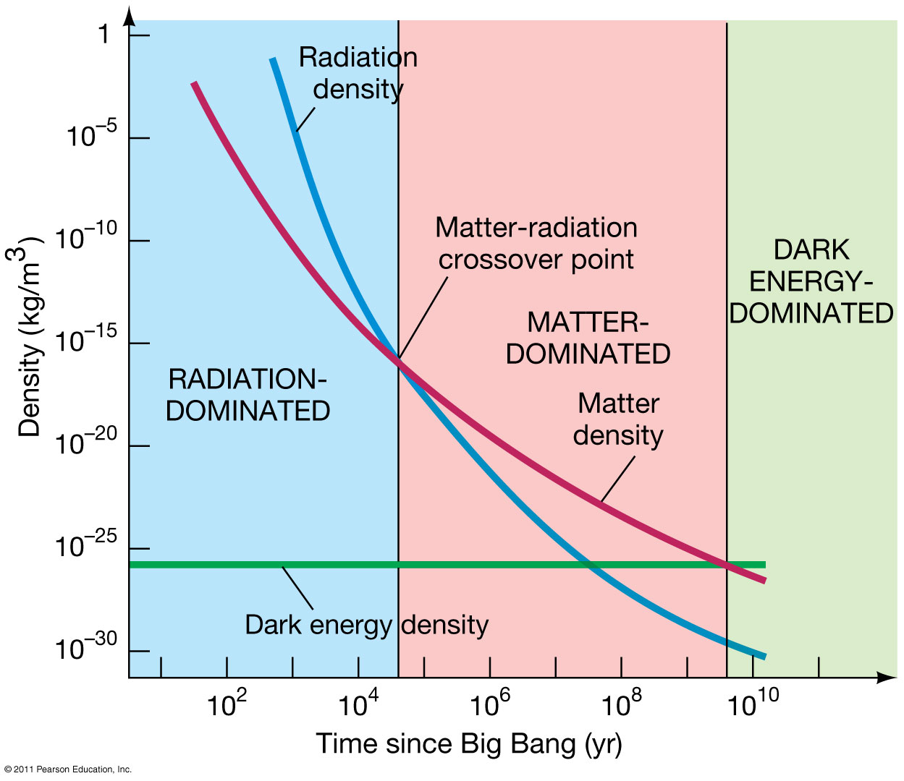

Slide 22
BUT!

Slide 23
The Horizon Problem

Slide 24
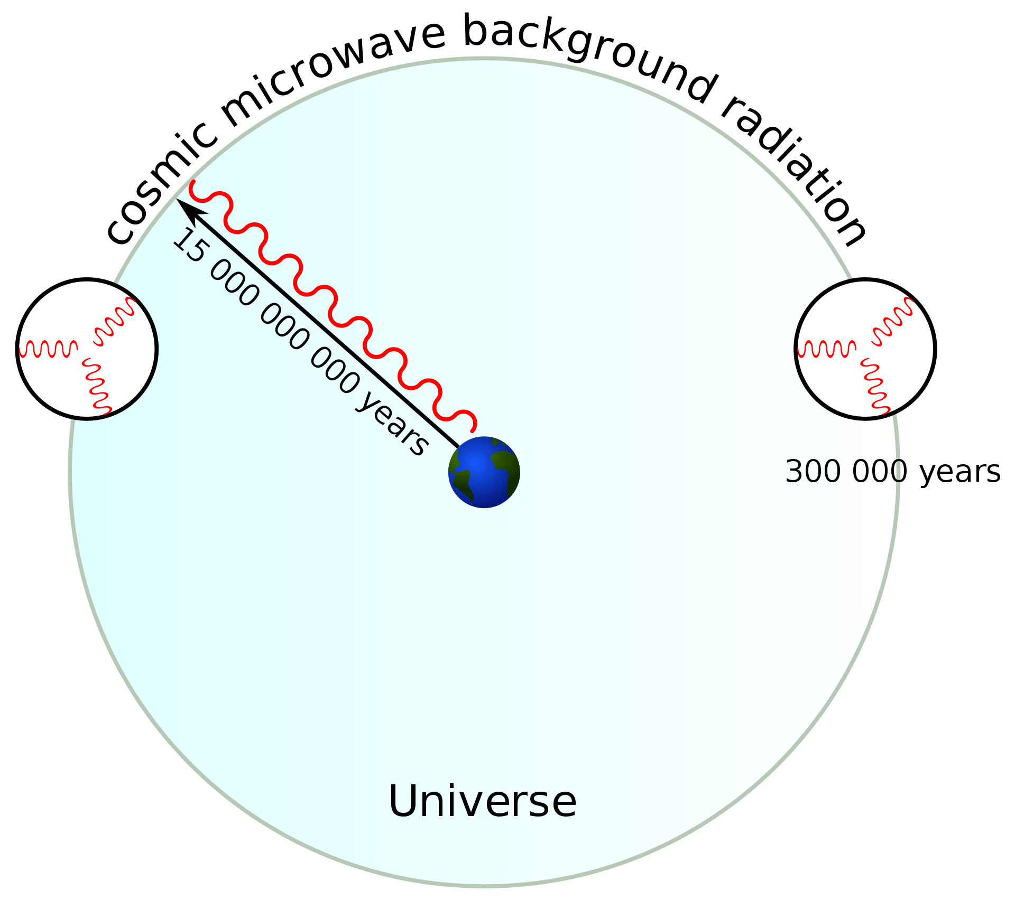
The Horizon Problem

Slide 25
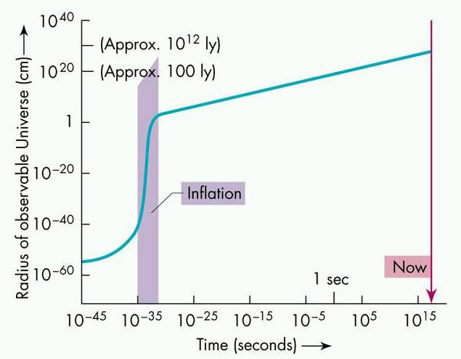
The Horizon Problem
Solution: “inflation”

Slide 26
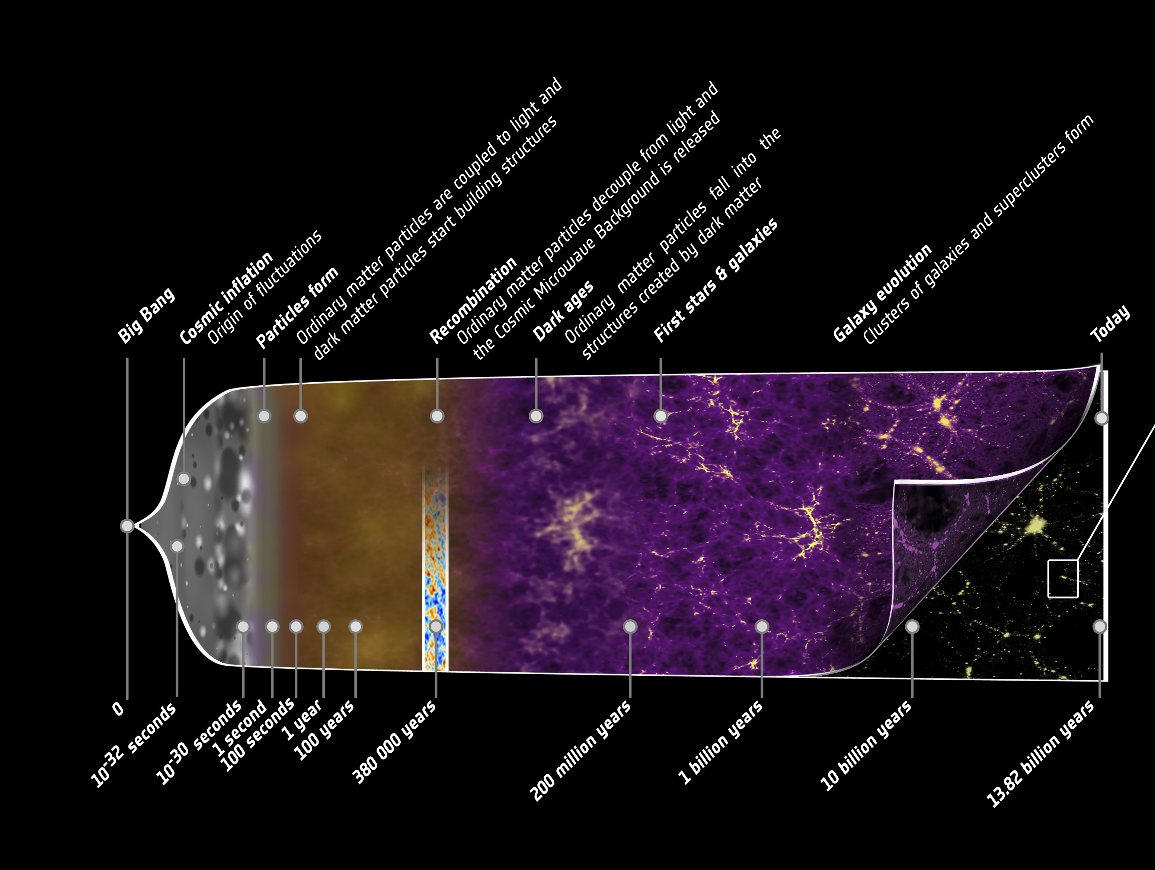

Slide 27
The Milky Way

Slide 28
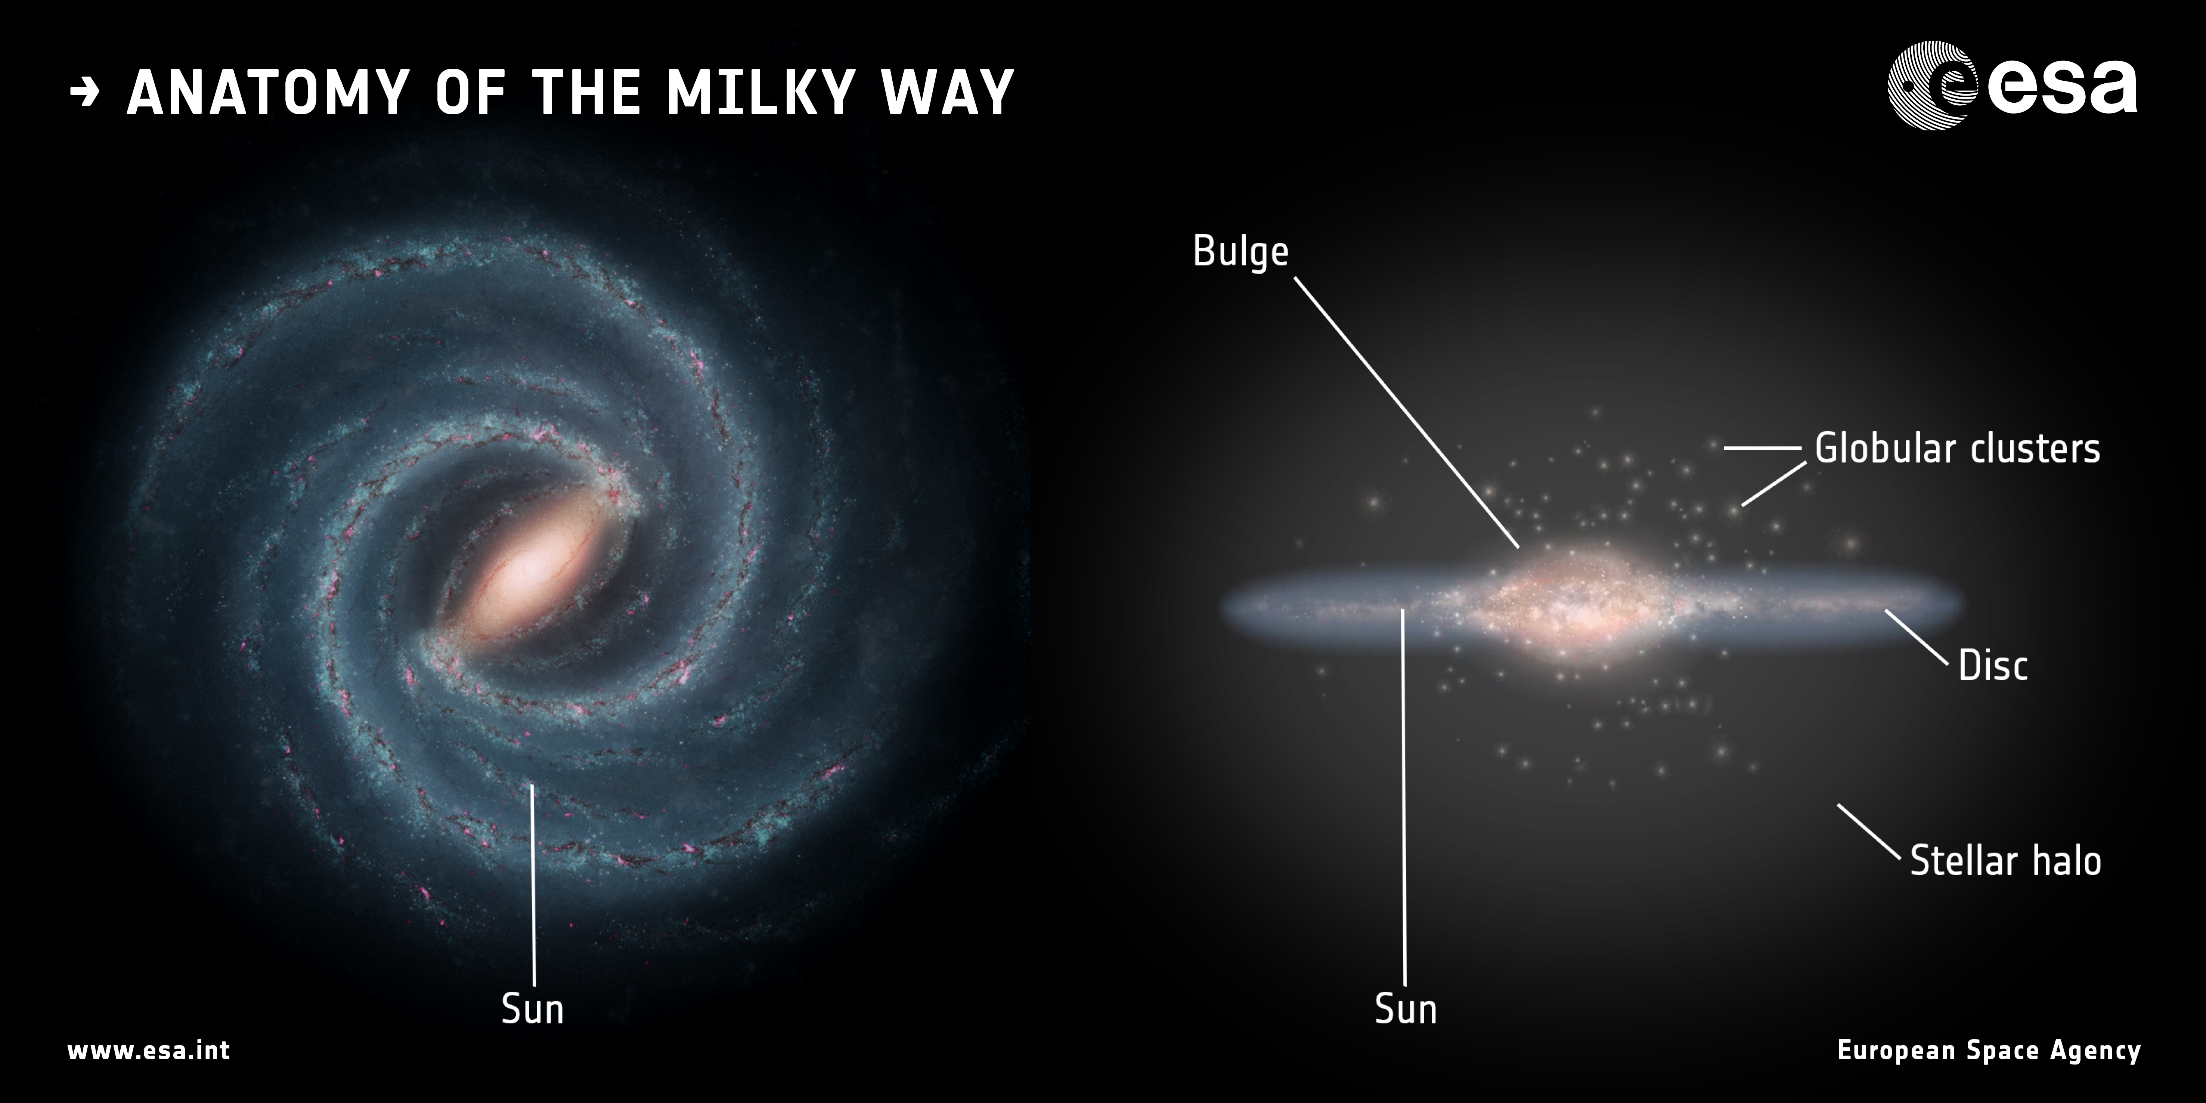

Slide 29
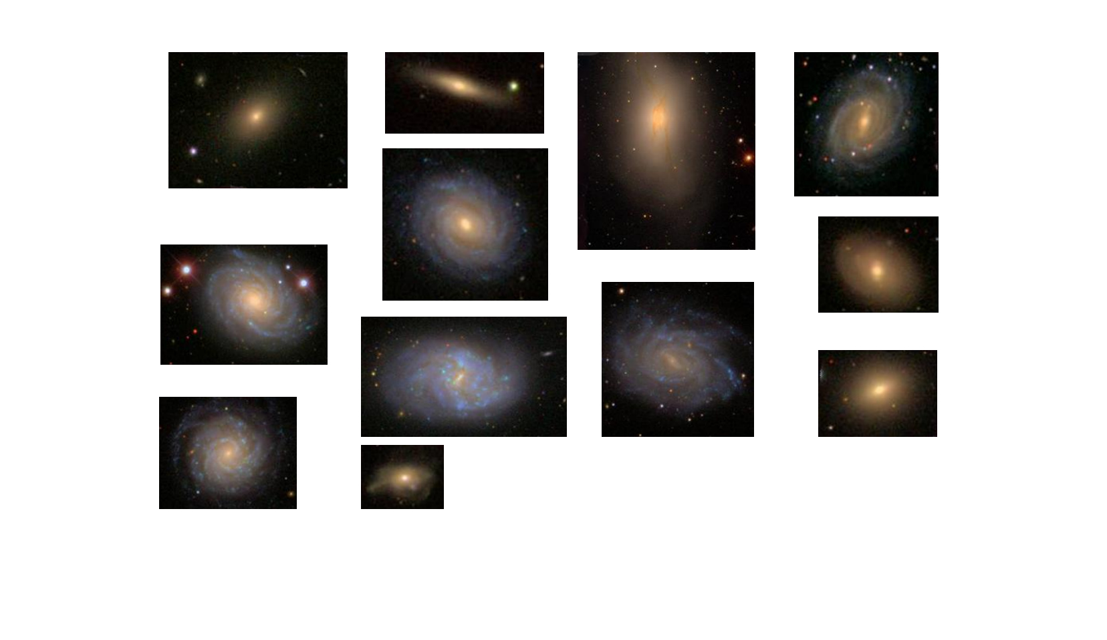

Slide 30
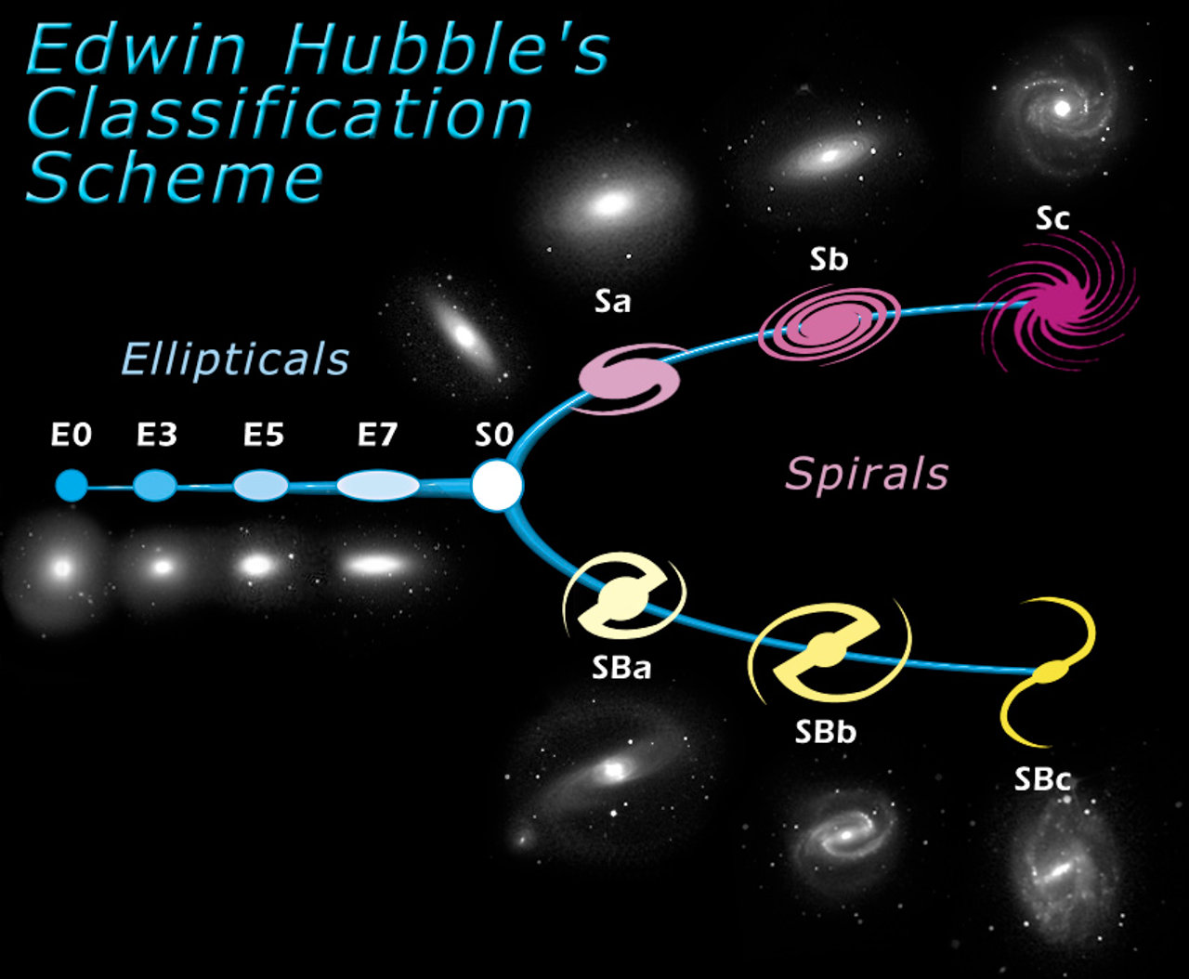

Slide 31
Why so many shapes?
Galaxy formation

Slide 32
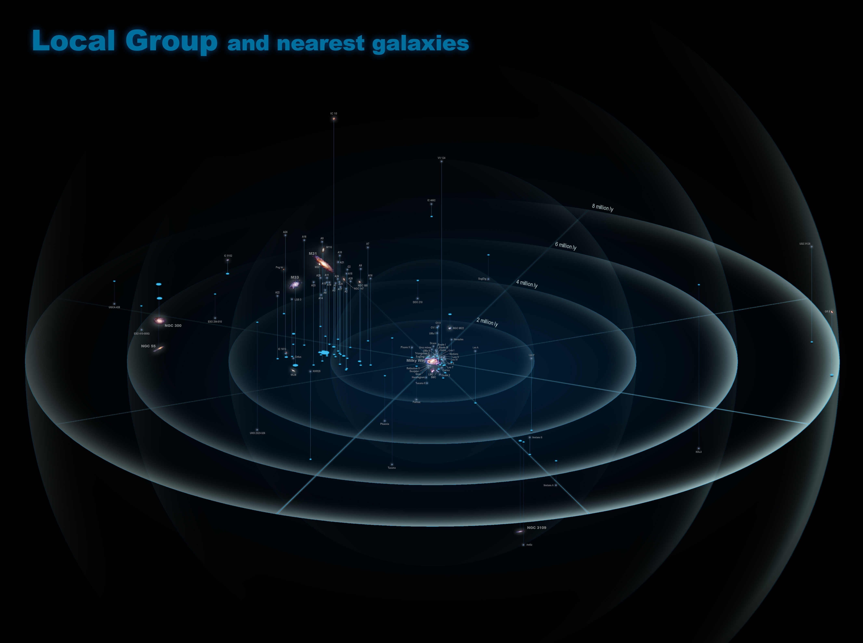
Why so many shapes?
Galaxy formation

Slide 33
Why so many shapes?
Galaxy formation

Slide 34
Crashing with Andromeda
The Clash

